Slide 1
PROPHYLAXIS AND HOMOEOPATHY
Dr.M.V.Ajithkumar
Prof & Head ,CM Dept
SKHMC
Dr.M.V.Ajithkumar
dRCM Dept
SKHMC

Slide 2
PROPHYLAXIS :
1. Prophylaxis :
synonyms:
Preventive treatment,
Prevention,
Protection .
Origin :
The word is Greek in origin, from the word ;phylax, meaning ;to guard;

Slide 3
Guarding from or preventing the spread or occurrence of disease or infection.
Tending to prevent

Slide 4
PREVENTIVE MEDICINE
“It is the science that includes specific medical measure and specific community measure in preventing diseases or ill health status” .

Slide 5
BIRTH OF PREVENTIVE MEDICINE :
Preventive medicine dates back to the 18th century. It is developed as a branch of medicine distinct from public health.
It came into existence even before the causative agents of diseases were known .

Slide 6
James Lind (1716-1794), a naval surgeon advocated the intake of fresh fruits and vegetables for the prevention of scurvy in 1753.
Edward Jenner (1749-1823) of Great Britain, discovered vaccination against smallpox in 1796.
These two discoveries marked the beginning of a new era, the era of disease prevention by specific measures.

Slide 7
The latter part of the 19th century was marked by such discoveries in preventive medicine as Pasteur's anti-rabies treatment (1883), cholera vaccine (1892), diphtheria antitoxin (1894), anti-typhoid year vaccine (1898), antiseptics and disinfectants (1827-1912), etc.
A further advance was the elucidation of the modes of disease transmission.

Slide 8
19 th Century – The New Era of Preventive Medicine.

Slide 9
KNOWLEDGE OF BACTERIAS

Slide 10
With the knowledge derived from bacteriology, it became possible to control disease by specific measures by blocking the channels of transmission, e.g., quarantine, water purification, pasteurization of milk, protection of foods, proper disposal of sewage, destruction of insects and disinfection. The development of laboratory methods for the early detection of disease was a further advance.

Slide 11
PROPHYLAXIS AND HOMOEOPATHY:

Slide 12
DISEASE Classification)
Indisposition
Surgical d/s
Dynamic d/s
Acute d/s
Chronic d/s
Individual
Sporadic
Epidemic
D/s with fully
developed symptoms
D/s with few
Developed symptoms
Non miasmatic
miasmatic
One-sided d/s
Local maladies
a/f=bad hygiene
Iatrogenic
occupational
simple
D/s with mental s/m
complex
Surgical Non- surgical surgical
Psora
Sycosis
syphilis
D/s Physical s/m
Psoric-sycotic
Psoric-syphilitic
Syco-syphilitic
Psoric-sycotic- syphilitic

Slide 13
Types of Acute diseases:
§73 – types of acute diseases
Acute disease
  individual
  sporadic
  epidemic

Slide 14
Individual:
This is a type of disease which attacks the humans individually due to some exciting cause of mental or physical origin .
(This acute disease is nothing but transient explosion of the latent psora).
Example:
Excessive intake of food or deficient supply of it, severe chill, over heating, strain, mental emotions etc act as exciting cause to develop individual acute diseases.

Slide 15
Sporadic :
These are the type of acute diseases that attack several persons at the same time here and there.
The exciting cause may be either climatic influences, atmospheric or physical agents (meteoric), or influences in the soil, water
(telluric) .

Slide 16
Epidemic diseases :
Epidemic diseases are the type of acute diseases that affects many persons, with very similar sufferings from the same cause.
Hahnemann uses the word infectious, in this context, because the epidemic disease becomes infectious when it spreads among the thickly populated areas.

Slide 17
APHORISMS

Slide 18
Genus epidemicus :
Genus epidemicus is the remedy selected homeopathically to those diseases in which several people have similar sufferings from the same cause. This genus epidemicus can be used not only as a curative but also as a preventive against this particular epidemic only.
For every new epidemic disease, the physician has to select a new“ genus epidemicus“ separately.

Slide 19
Genus
Epidemicus (A Remedy)
Disease
Several people
affected
By the same cause

Slide 20
CASE TAKING IN Genus epidemicus : § 102
1.To find the true picture of the epidemic disease
we need to write down the signs and symptoms collected from those affected by it.
2.After noting all these symptoms we have to elicit the prominent and peculiar symptom of the disease. In epidemic disease all are exposed to particular cause .
3.But to get the complete picture of all the totality we have to take survey of this particular suffering from several patients of different constitutions .

Slide 21
4. Hence to select a specific remedy for a disease, we require collecting all its peculiar signs and symptoms from patients who are affected by it and then the remedy that suits the prominent peculiar and characteristic symptoms of totality has to be selected.
5. The medicine that covers totality of symptom of epidemic disease is called as genus epidemicus .

Slide 22
Uses of the genus epidemicus :
1.For the treatment of the epidemic disease: Once the task of selecting the genus epidemicus is over, the labor of selecting individual remedy for each and every person separately is also over. This helps in saving the time of the physician and helps in treating several patients in relatively short period in effective manner.

Slide 23
2.For the preventive purposes: The same genus epidemicus can be
used as the preventive medicine for each and every healthy person in that epidemic area. Hence genus epidemicus is used as preventive as well as the curative remedy .

Slide 24
EXAMPLES OF GENUS EPIDEMICUS REMEDY BY DR. HAHNEMANN

Slide 25
Example: (footnote to § 73)
Hahnemann used “Belladonna” as genus epidemicus for the epidemic
diseases called the Scarlet fever in the year 1801.
A kind of purpura miliaris which came from the west was also successfully controlled by the use of Aconite. This was the genus epidemicus of that particular epidemic .

Slide 26
LESSER WRITTINGS

Slide 27
PREVENTION OF ASCIATIC CHOLERA ;
(DR.BOENNINGHAUSEN)
Intake of Cuprum with good and moderate diet and proper attentive cleanliness is the best preventive and protective measure.
healthy individuals in the affected area should take once every week a small globule of cuprum in the morning and not to drink anything immediately afterward.
Camphor can’t preventive or preserve those healthy ones so vapor of Camphor even must be avoided. Otherwise it will suspend the action of Cuprum.

Slide 28
PROPHYLAXIS OF SCARLET FEVER:
DR.HAHNEMANN
Inspite of well advanced medical treatment always there is a chance for death,so inorder to protect those in health there must be some preventive medicines
Dr.Hahnemann discovered Belladonna as a specific preventive remedy for it. He says Bell alone can fulfill most of the indications of this disease.

Slide 29
Its power to produce synochus with erysipelatous spots on the skin,swollen hot face couldn't fail to be extremely appropriate the symptoms of full scarlatina. He says, A remedy that quickly checking a disease in its onset must be its best preventive and he proved this in an experience of his. Bell a dose once in 72 hours.

Slide 30
Preparation of Belladonna :
Take hand full of fresh leaves of wild belladonna,at the season before flowering –grind it in a mortar -extract the juice -immediately spread it out as plate-expose it in a drought of dry air -evaporate in few hours -until it becomes dry to be pulverized. The powder must be kept in a well corked bottle. A grain of this powder in 100 drops of distilled water by rubbing it up in a small mortar -pour this thick solution into a one ounce bottle and rinse the mortar and pestle with 300 drops of diluted alcohol -label as strong solution -1 drop of this is mixed with 300 drops of diluted alcohol -shake-label as medium solution. Of this second mixer one drop is mixed with 20 drops of diluted alcohol by shaking -label as weak solution of Bell.
This weak solution only is used as prophylactic .

Slide 31
Importance of Prophylaxis :
The aim of prophylaxis is to inhibit the disease process itself and to improve the quality of life and well being of an individual as well as the community.
In order to achieve this aim, the following objectives can be formed:
1.Improving the nutritional status of the individual and the community.
2.Maintaining and training of personal and social hygiene.
3.Protecting the ecological balance and providing sanitary and hygiene environment.

Slide 32
4. Educating the public on subjects like infectious diseases and their mode of spread, health maintenance, making them aware of the genetically transmitted disease and their management.
5. Educating the people on occupational diseases, carcinogenic agents, allergic manifestations and the allergens
Such health promoting measures are accepted in all systems of medicine

Slide 33
Vaccination:
It is a method of giving antigens to stimulate the immune response through active immunization.
A vaccine is an immune biological substance designed to produce specific protection against a given disease.

Slide 34
Routes of administration:
Deep subcutaneous or intramuscular route [ most vaccine]
Oral vaccine [ oral BCG vaccine]
Intradermal [ BCG vaccine]
Intranasal route [ live attenuated influenza vaccine]

Slide 35
Homoeoprophylaxis:
Homoeoprophylaxis is the method of using homoeopathic remedies to prevent infectious disease.
Goal :it is to orally introduce safe, homoeopathic remedies in order to naturally stimulate the immune system.
There are no toxins ,chemicals ,or pahtological particles used in treatment

Slide 36
Homoeoprophylaxis:
The hahnemannian process is purely physical, objective and mechanical.
It does not involve any certain, unseen, unreliable nor unmeasurable factors
Its resulting product is stable and is under homoeopathic methods and principles and has proved it to be efficient
The process is practical illimitable.
Dynamic of homoeoprophylaxis according to law of similars is very effective in practice only in, the form of Dynamic dose, which is very essential.

Slide 37
Eg. of Dynamic Homoeoprophylaxis
Prevention of red rashes of Scarlatina during the epidemic with dynamic doses of Belladonna
Dynamic dose of Thuja Occidentalis – prophylactic against small pox in epidemics

Slide 38
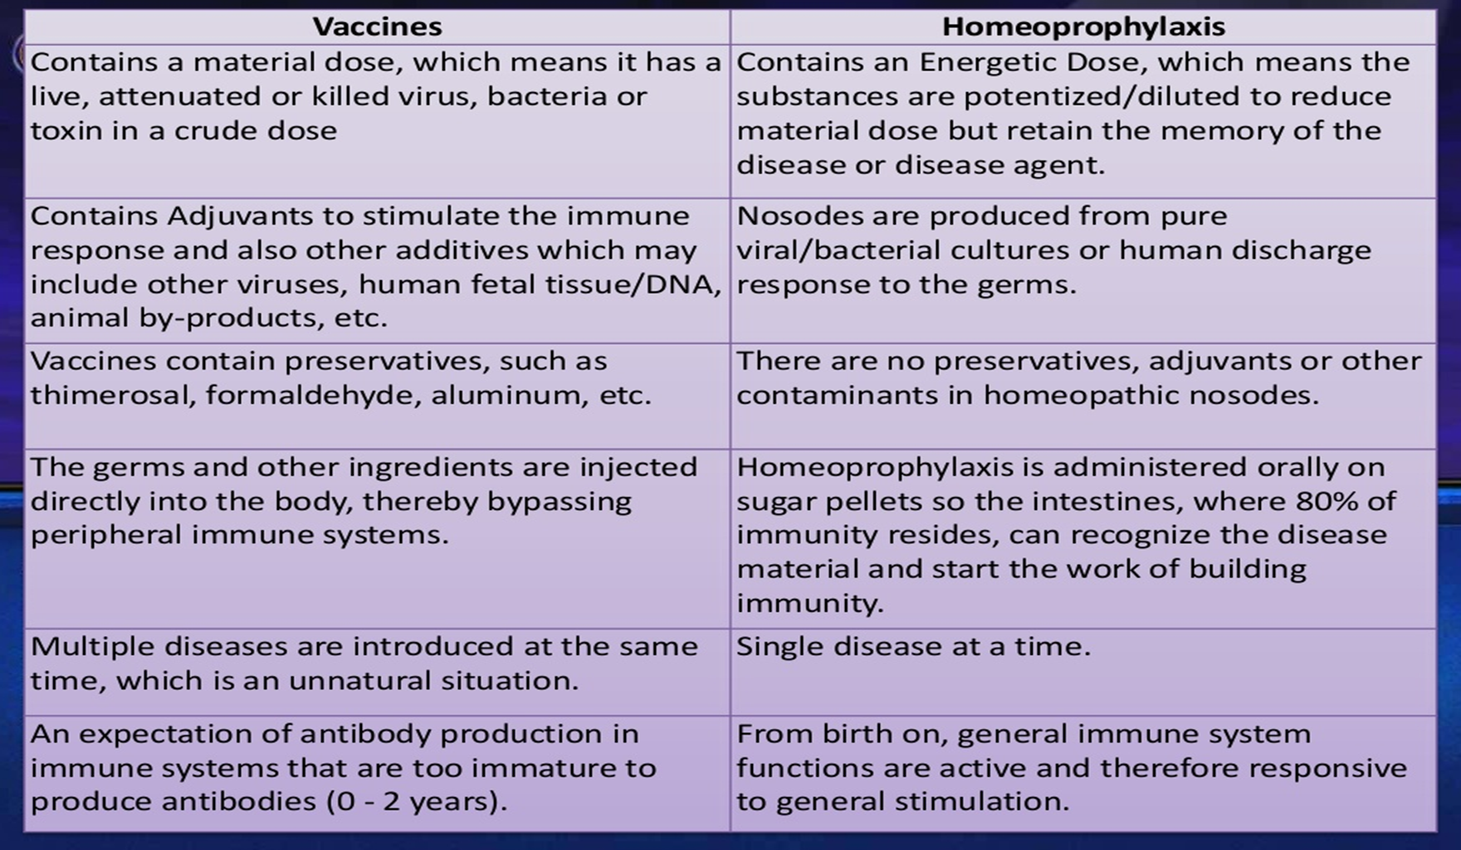

Slide 39
Reference
Organon of medicine-Dr. Samuel Hahnemann
Chronic diseases-Dr.Samuel Hahnemann
Lesser writing -Dr. Samuel Hahnemann

